Slide 1
Mirror Visual Feedback
Guide to performing this technique effectively
You will need:
A mirror large enough to completely conceal the affected limb without defects/ distortions
  A mirrored wardrobe door might be suitable in the home or a large free standing mirror
A quiet space
A starting position with patient well supported and comfortable

Slide 2
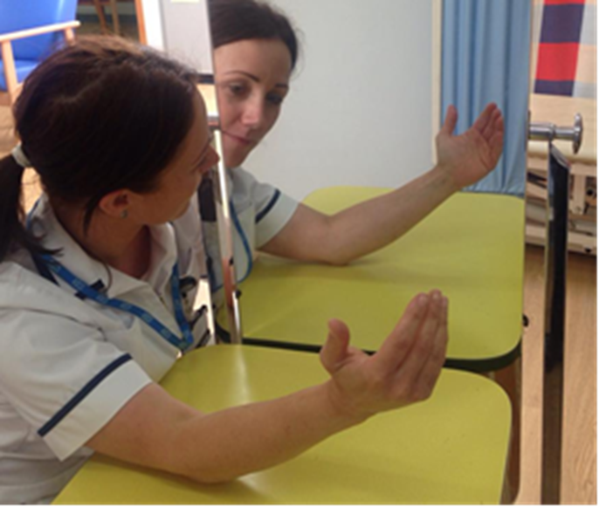
Mirror Visual Feedback
Before starting
Record size of painful area, pain score, feelings of stiffness/ ownership, colour and temperature of limb
Warn patient that this may feel strange and they can stop any time if they don’t like the feeling
Remove jewelry if possible

Slide 3
Mirror Visual Feedback
Position
Quiet room
No distractions
Affected limb behind the mirror : not visible
Unaffected limb in front of mirror: not in direct line of vision
The same starting position for both limbs

Slide 4
Mirror Visual Feedback
Accepting the image
Ensure you are not in the patients line of sight or reflection
Ask the patient to lean forward, look at the reflection of their limb without moving either limb
Ask patient to concentrate on the reflection until they feel comfortable with it

Slide 5
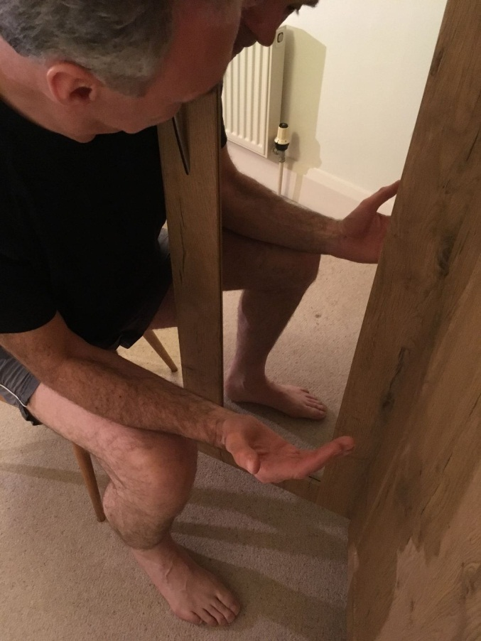
Mirror Visual Feedback
Starting
Slowly start congruent movement of both limbs whilst looking at the reflection
Start with larger, pain free, smooth, bilateral movements
Perform slowly with conscious attention
Exercise: at least 5 mins but no longer than ten

Slide 6
Mirror Visual Feedback
Refining movements
Regime requires a lot of concentration/ can be tiring if performed correctly
Progress to smaller, more complex movements

Slide 7
Mirror Visual Feedback
Advice to patient
If pain or stiffness becomes a problem whilst exercising:
stop, look at the image without moving either limb until the pain settles
Recommence as able

Slide 8
Mirror Visual Feedback
Monitoring effect
Immediately after session note:
if and how long pain is relieved
colour and temperature response
any changes in stiffness/ feeling of ownership of limb

Slide 9
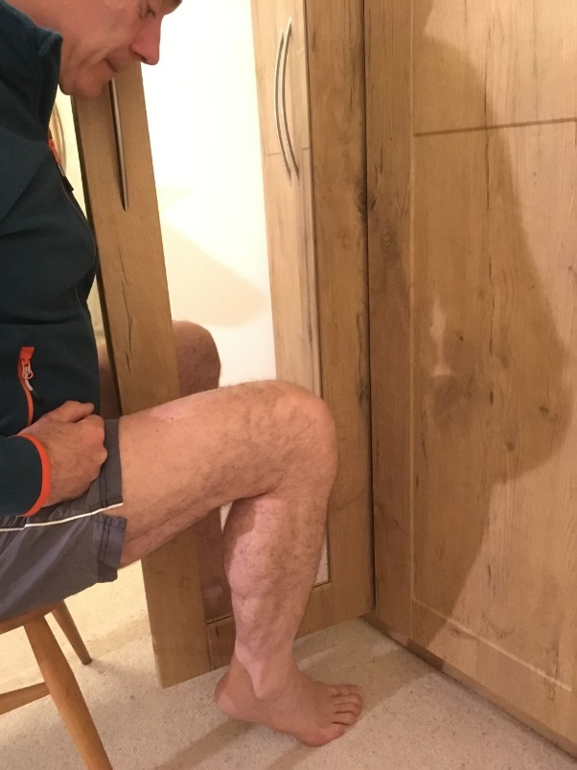
Mirror visual feedback
Advice to patient for home programme
Need a calm space and time to concentrate
You can use a mirror on a wardrobe
Repeat 4-9 times daily
5-10 minutes at a time to maintain concentration

Slide 10
Mirror Visual Feedback
Progression
Gradually reduce mirror use as pain decreased

Slide 11
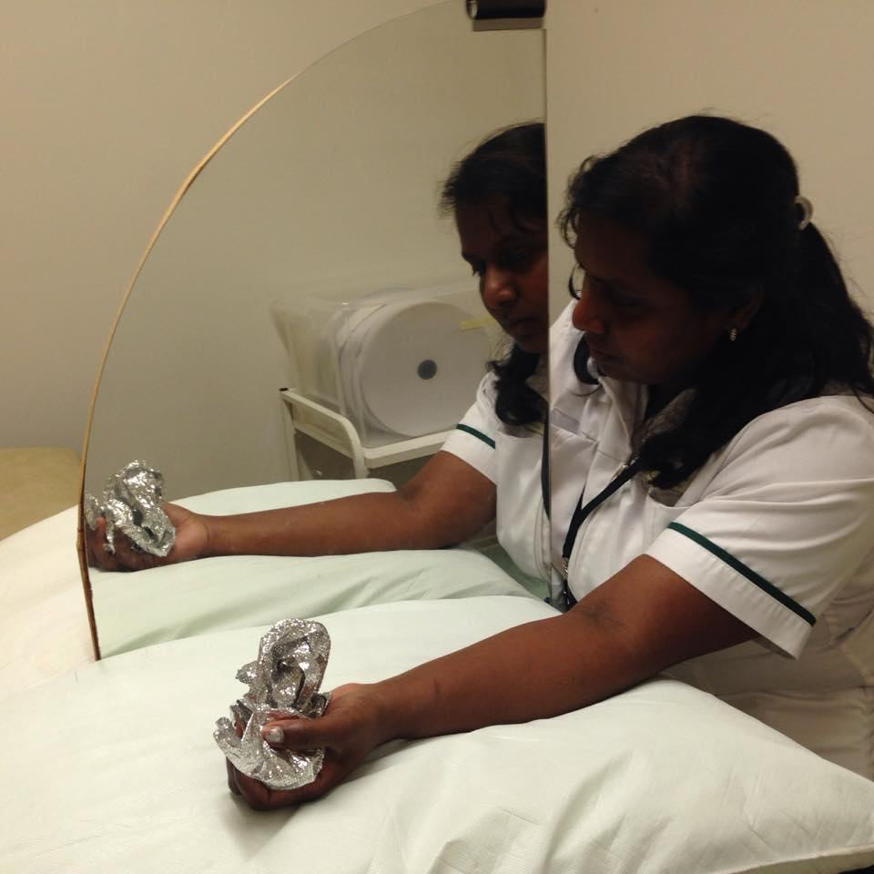
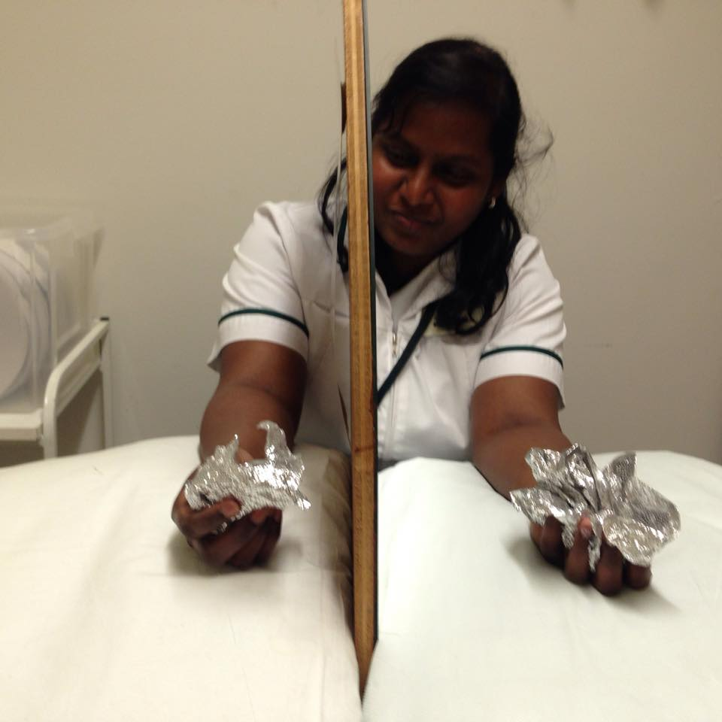
Mirror Visual Feedback
Progression
Tactile training can be added

Slide 12
M V F Tips
Do
Stop & look at the image without moving either limb if pain or stiffness develops
Recommence when able
Start with more proximal joints if distal too painful
Don’t
Sit back from mirror so that you can see both arms
Perform incongruent movements
Continue if symptoms worsen

